Slide 1

min(sum(4u))
Ng Rui Qin | Randy Lai | Vincent Tok

Slide 2
Contents
Introduction
Problem Identification
Analysis
Conclusion

Slide 3
Introduction
Ageing population in Singapore
47% aged > 65 by 2030 ¹
Millennials are not literate in financial planning ²
Lead to insufficient funds for retirement
¹Evelyn Eng: Millennials need wise financial planning in gig economy - https://www.todayonline.com/voices/millennials-need-wise-financial-planning-gig-economy
²Siau Ming En: Elderly to make up almost half of S’pore population by 2050: United Nations - https://www.todayonline.com/singapore/elderly-make-almost-half-spore-population-2050-united-nations

Slide 4
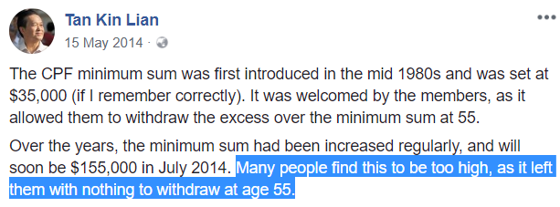
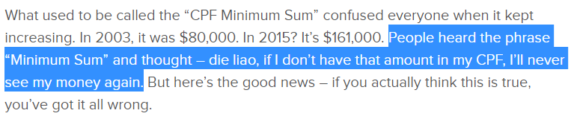
Problem Identification
CPF Retirement Sum Scheme indicates that it is the sum that is required to support a basic standard of living upon retirement.

Slide 5
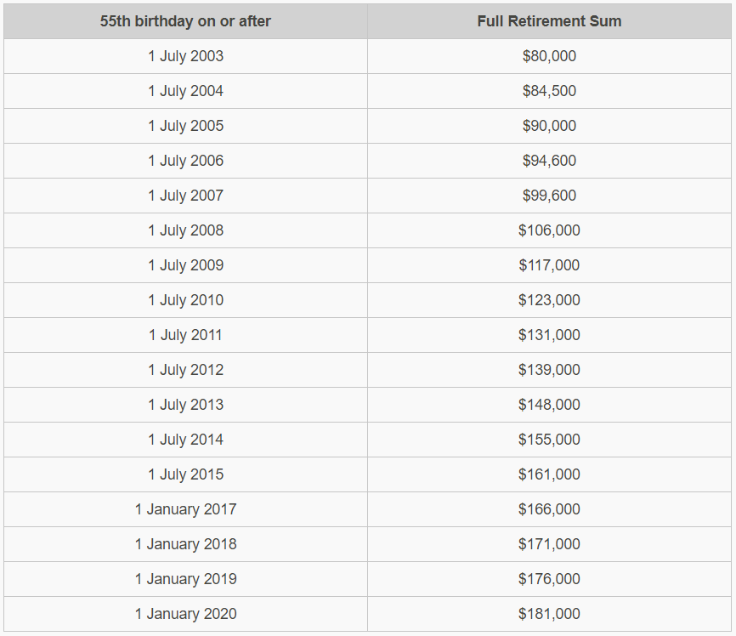
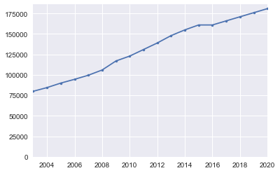
Minimum Sum

Slide 6
Factors Affecting Analysis
Static Analysis: Linear CPF growth (baseline, assuming status quo)
Dynamic Analysis: Different predicted values when housing and insurance factors are included

Slide 7


APIs Used
v1.3
CPF Calculator
NTUC Income
v2.1
Mortgage Calculator

Slide 8




Packages/Frameworks Used

Slide 9

Conclusion
Seek to educate our youth on retirement planning
Start young and plan ahead

Slide 10
END OF PRESENTATION
Any questions?

Slide 11
Appendix: CPF Retirement Sum Scheme
Withdrawal at 55
Higher of $5,000 or savings above Full Retirement Sum
Need to set aside:
CPF Minimum Sum - $155,000
Medisave Minimum Sum - $43,500

Slide 12
Appendix: CPF Retirement Sum Scheme
3 Options:
Basic Retirement Sum (BRS)
Full Retirement Sum (FRS)
Enhanced Retirement Sum (ERS)

